Slide 1

Fatigue Failure of Materials
Lectures in Fracture Mechanics
National Institute of Technology Tiruchirappalli

Slide 2
Introduction to fatigue failures
Laboratory testing vs real life
In real life conditions, the component is subjected to several harsh conditions.
Causes:
Fluctuating loads, known as fatigue loads.
combined effect of stresses and a corrosive environment.
Even abundant materials like water or its vapours, various salts, oils, edible items are known to cause the growth of subcritical cracks to their critical length.

Slide 3
Fatigue and fatigue load
Fatigue:
Fatigue is defined as a phenomenon of failure of components under fatigue stress having less than yield strength (ductile material) or less than ultimate strength (brittle material).
Fatigue load:
Fatigue load is defined as the load whose magnitude or direction or both magnitude and direction changes w.r.t. time and repeatedly applied.

Slide 4
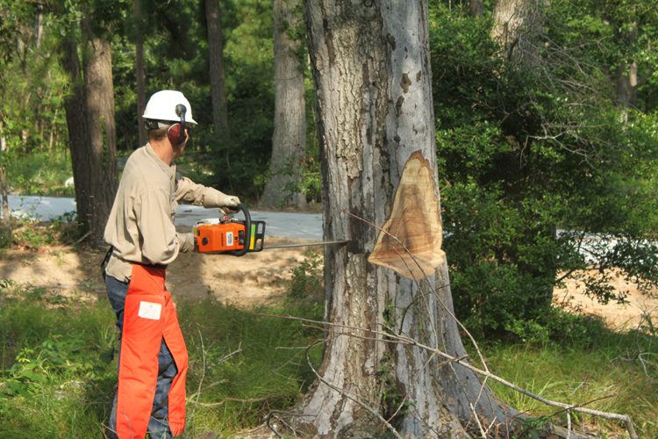
Examples of Fatigue failure
Chip off the trunk bit by bit with the saw until the groove becomes large so that the tree can be pulled down easily with a rope.
The process is slow but repeated action makes it fall.

Slide 5
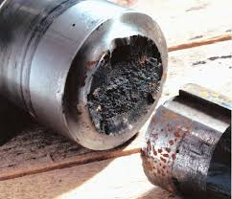
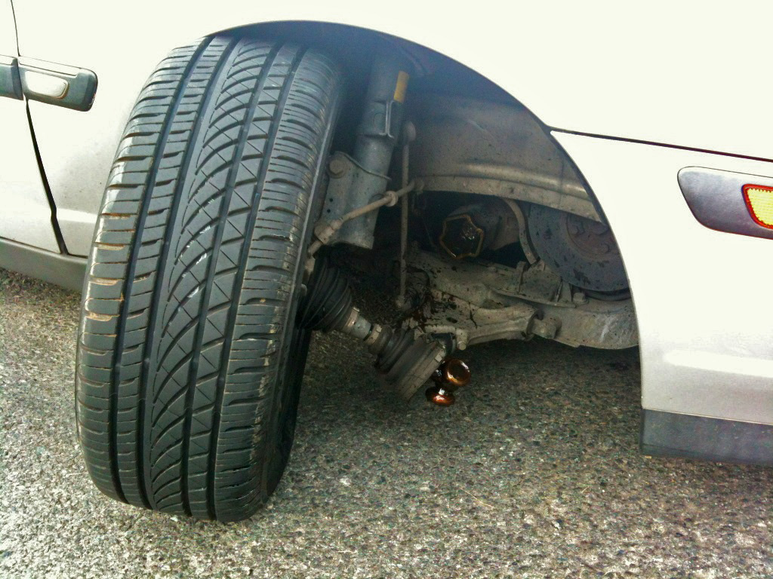
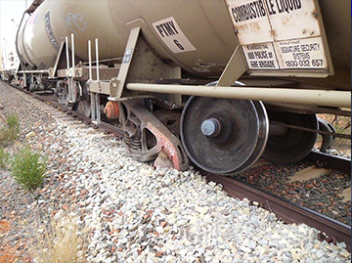
Axles and shafts
Shafts are designed to carry torque, but lateral loads, which generate
bending moments, cannot be avoided. Consequently, a fiber on the shaft surface which is aligned parallel to the axis is subjected to tensile and compressive stresses in every rotation

Slide 6
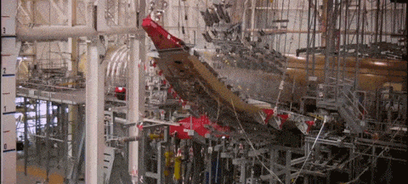
Airplane wings
In a newly developed airplane before the flight test, the entire wing is experimentally tested to fluctuating wind loads, simulated in the laboratory, till it fails.

Slide 7
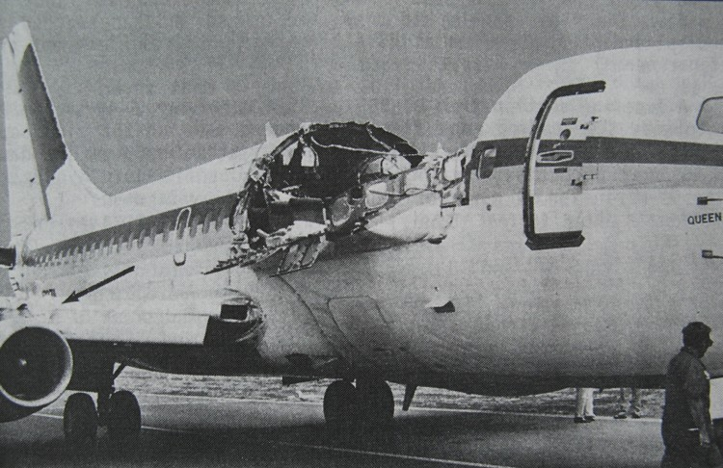
Airplane fuselage
Owing to a fatigue crack growth nucleated near an opening in its fuselage.
The fuselage of a plane is subjected to one cycle of pressure per flight because at high altitude the air pressure is increased inside to make it comfortable for the passengers.

Slide 8
Stress cycles terminology
There are two kinds of fatigue loads,
Constant amplitude load:- loads on locomotive axles
Variable amplitude load:- Fluctuating wind load on a wing of an airplane
Stress cycle:
It is the smallest portion of stress-time plot which is repeated periodically and identically.

Slide 9
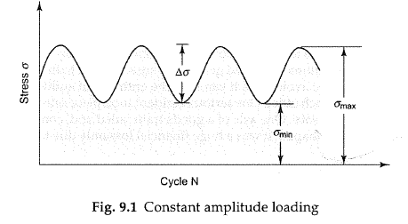
Constant amplitude loading

Slide 10
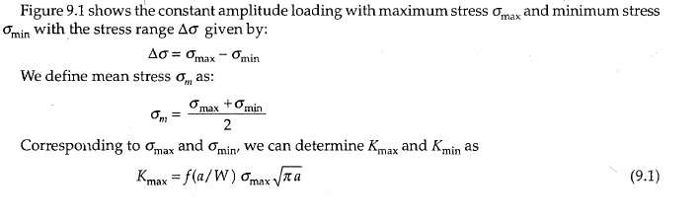

Slide 11
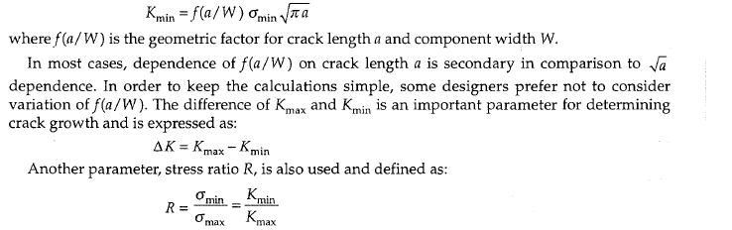

Slide 12
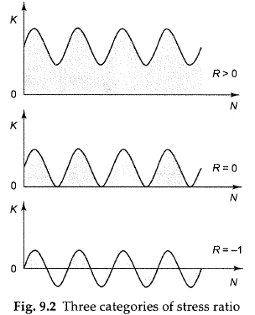

Slide 13
S-N Curve
Completely reversed stressed condition is the worst fatigue condition because it is having stress ratio R = -1.
Therefore fatigue test is conducted to determine failure stress under this condition.
Using the Fatigue test machine an empirical relation is determined between applied stress (peak value of the fluctuating load) and number of cycles N required to cause the failure.
The relation is generally known as S-N curve.
At a higher stress, of course, the component has a shorter fatigue life.

Slide 14
S-N curve for steel with endurance limit

Slide 15
S-N curve for non ferrous metals with no endurance limit

Slide 16
Endurance limit:
It is defined as the maximum value of completely reversed bending stress that a material can withstand for an infinite no of cycles without a fatigue failure.
For steel, it is found that below the endurance limit the material does not fail. However, distinct endurance limit is not observed for nonferrous metals.
Common practice-design a steel component such that the critical stress does not exceed endurance limit.
For nonferrous metals, conventional design approach has been used to determine allowable stress סa for a reasonable number of cycles, say 10⁸ cycles.

Slide 17
Limitations of s-n curve
An S-N curve adopts a black-box approach and it does not explore the mechanisms of failure.
It does not even distinguish between initiation life and propagation life.
Only overall fatigue life is taken into account.
There is no consideration of the specimen size.
Also, the data on an S-N curve has a large scatter suggesting that the formulation needs to be more rigorous.
A component, designed on the basis of endurance limit, may still fail during its use.

Slide 18
Project analysis slide 3
FATIGUE CRACK PROPAGATION

Slide 19
Project analysis slide 3
INTRODUCTION
FATIGUE FAILURE
Failure that occurs under fluctuating/cyclic loads–Fatigue.
Fatigue occurs at stresses that are considerably smaller than yield/tensile stress of the material.
Fatigue failures occur in both metallic and non-metallic materials, and are responsible for a large fraction of identifiable service failures of metals.
It is estimated that fatigue accounts for ~90% of all service failures due to mechanical causes
Crack growth is a slow process where as fracture is an ultra fast process

Slide 20
FACTORS AFFECTING FATIGUE FAILURE
Three factors play an important role in fatigue failure:
(i) Value of tensile stress (maximum): Sufficiently high maximum tensile stress
(ii) Magnitude of variation in stress: Large variation/fluctuation in stress
(iii) Number of cycles: Sufficiently large number of stress cycles
Geometrical (specimen geometry) and microstructural aspects also play an important role in determining fatigue life (and failure). Stress concentrators from both these sources have a deleterious effect.
Residual stress and corrosive environment can have a deleterious interplay with fatigue.

Slide 21
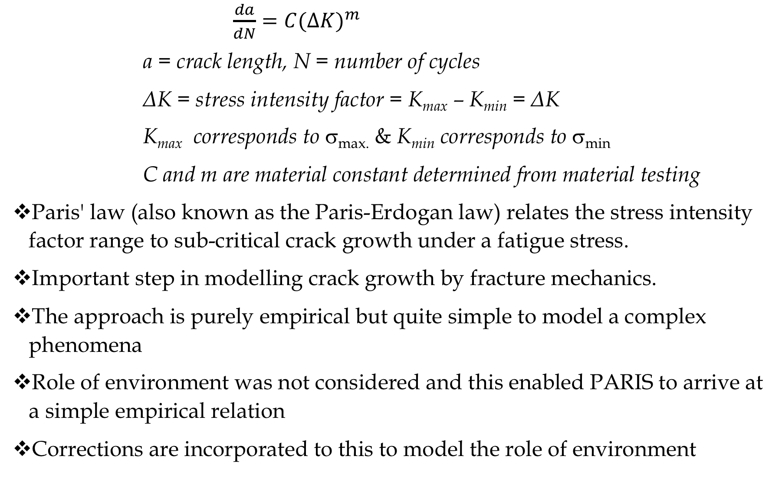
Project analysis slide 5
PARIS Law
$\frac{da}{dN}=C(Δ{K)}^{m}$
a = crack length, N = number of cycles
ΔK = stress intensity factor = K_{max} – K_{min} = ΔK
K_{max} corresponds to σ_{max.} & K_{min} corresponds to σ_{min}
C and m are material constant determined from material testing
Paris' law (also known as the Paris-Erdogan law) relates the stress intensity factor range to sub-critical crack growth under a fatigue stress.
Important step in modelling crack growth by fracture mechanics.
The approach is purely empirical but quite simple to model a complex phenomena
Role of environment was not considered and this enabled PARIS to arrive at a simple empirical relation
Corrections are incorporated to this to model the role of environment

Slide 22
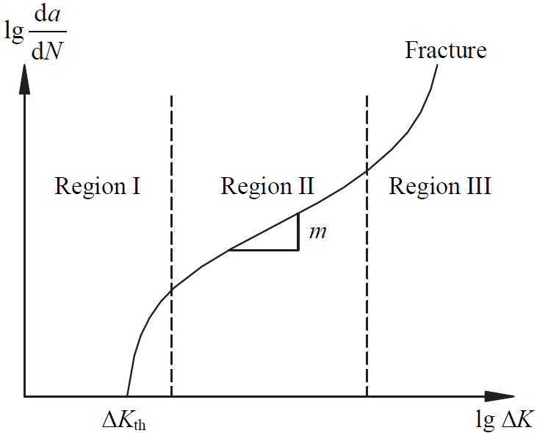
Project analysis slide 6
SIGMOIDAL CURVE
Once the crack nucleates (stage I), the relevant parameter characterizing the mechanical behavior of the material is the stress intensity factor and not the stress (alone).
So a logical plot should be between da/dN and the range of stress intensity factors (ΔK) experienced by the specimen.
The shape of the crack growth rate curve from crack initiation to catastrophic failure is a sigmoidal curve.
From the graph three important stages of fatigue can be identified.
Stage 1 – Crack initiation
Stage 2 – Crack propagation
Stage 3 – Catastrophic failure

Slide 23
Project analysis slide 7
Stage 1 – Crack Initiation
Mostly occurs at surfaces or sometimes at internal interfaces. In structural components, crack initiation observed to occur at the tip of an existing defect, a slit, at some point of a free surface, a void or an inclusion.
It may take place within about 10% of the total life of the component
(in notched specimens this stage may be absent).
There exists a threshold value of ΔK, below which fatigue cracks will not propagate.
Crack growth is extremely small of the order of nanometers and not uniform over even small distances along the crack front. So, fatigue striations are not formed.
Microstructure, mean stress and environment have a large influence.
Maximum life of the component is in this region.
For small ΔK crack propagation is difficult to predict since it depends on microstructure and flow properties of the material. Here, the growth may even come to an arrest.
Number of cycles required to initiate a crack and then make it to grow to a detectable length is known as initiation life

Slide 24
Crack initiation is by formation of Intrusion and Extrusion.
Yield stress (σ_{y}) is the macroscopic yield stress and microscopic yielding
(by slip) is initiated at a much lower stress value.
Slip steps are generated by dislocation motion of slip planes.
Slip steps don’t always go away on load reversal (dislocation don’t always reverse their course).
In cyclic loading, due to reversal of slip direction, the surface steps are created. Further this can lead to extrusions and intrusions.
Intrusions can be caused on the surface, which are like small surface cracks, can act like a notch, which is a stress concentrator and thus lead to crack propagation.
Once a crack forms from these intrusions (due to further cyclic loading), local stress amplification takes place.
Results in surface roughening.
In uniaxial loading this slip usually does not lead to any appreciable effects or damage to the material/component

Slide 25
Project analysis slide 8

Slide 26
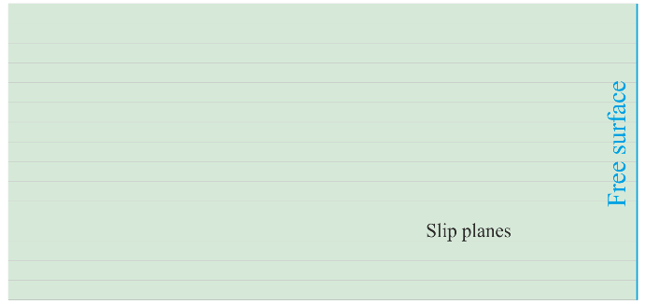
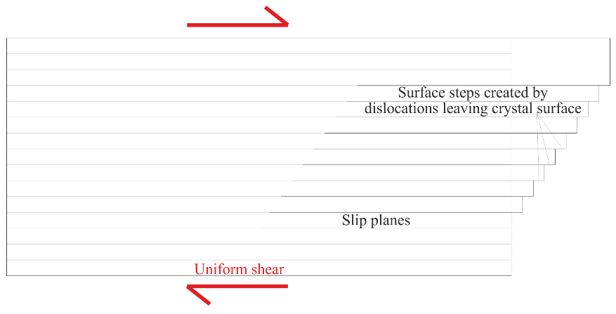
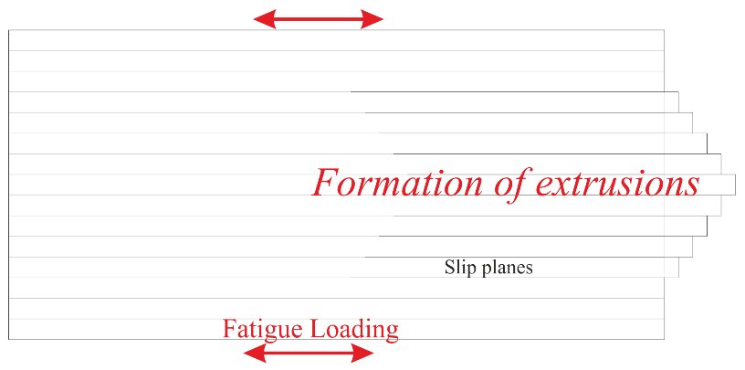
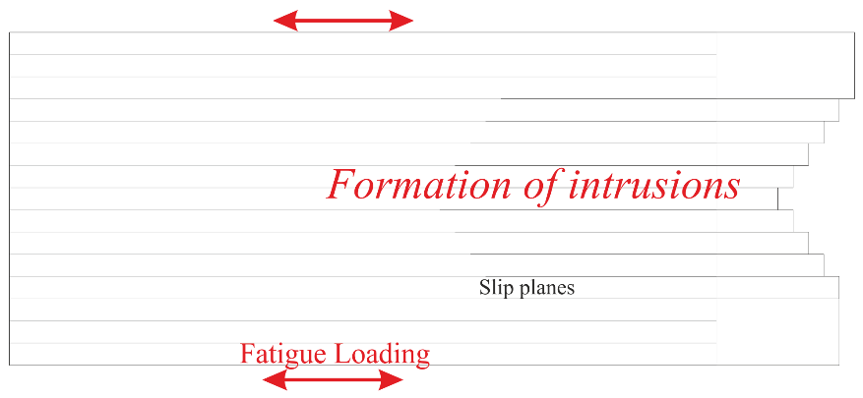
Project analysis slide 10

Slide 28
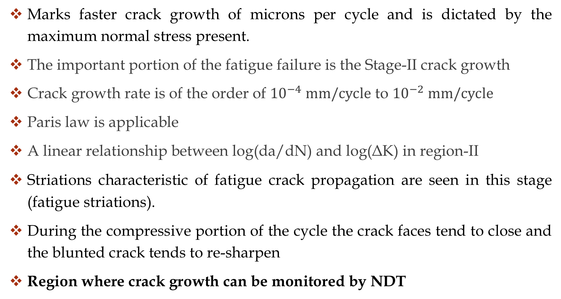
Stage 2 – Crack Propagation
Marks faster crack growth of microns per cycle and is dictated by the maximum normal stress present.
The important portion of the fatigue failure is the Stage-II crack growth
Crack growth rate is of the order of ${10}^{−4} mm/cycle$ to ${10}^{−2} mm/cycle$
Paris law is applicable
A linear relationship between log(da/dN) and log(ΔK) in region-II
Striations characteristic of fatigue crack propagation are seen in this stage (fatigue striations).
During the compressive portion of the cycle the crack faces tend to close and the blunted crack tends to re-sharpen
Region where crack growth can be monitored by NDT

Slide 29
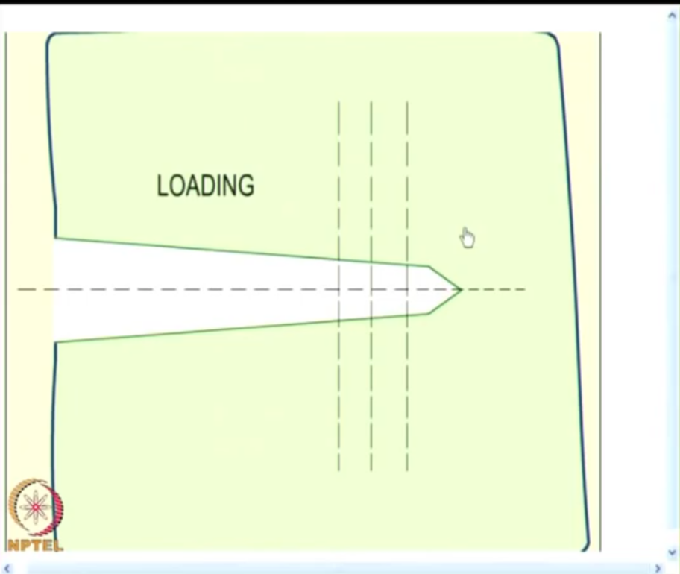
Project analysis slide 4
Plastic deformation at the crack tip occurs because of high stress concentration even at very low external loads.
Plastic deformation is slip of atomic planes due to shear stresses.
Crack tip blunts due to plastic deformation.
When loading is removed crack tip becomes sharp.
This process is repeated for subsequent load cycles.
Change in crack length after each cycle will be different.
Rate of change of ‘change in crack length’ (Δa) will increase after each cycle.
In fatigue testes inherent flaws grow due to fatigue crack growth mechanism and reach a critical level which leads to fracture.
S-N curve doesn’t give the information about the life of material with crack when cyclic load is applied.

Slide 30
STRIATIONS
Very tiny closely spaced ridges that identify the tip of the crack at some point in time.
Ridges are formed due to repeated opening and closing.
Cannot be seen by naked eyes.
Each striation is produced by one cycle of stress
(One Δa corresponds to formation of one striation).
Sometimes these striations are difficult to detect and hence if striations are not found it does not imply that fatigue crack propagation was absent.
Very long crack growth may happen due to overload.
Depends on composition of the material.

Slide 31
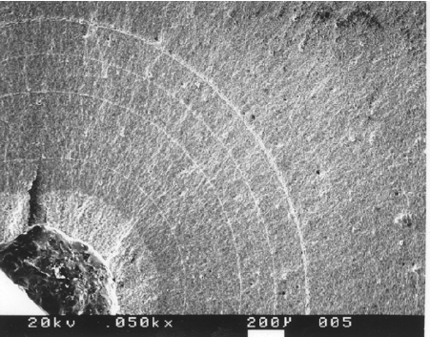
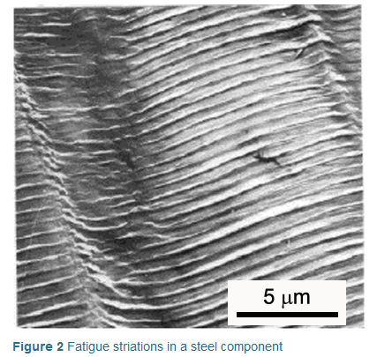
Fatigue striations in a steel component

Slide 32
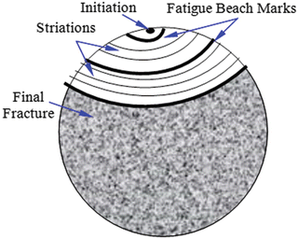
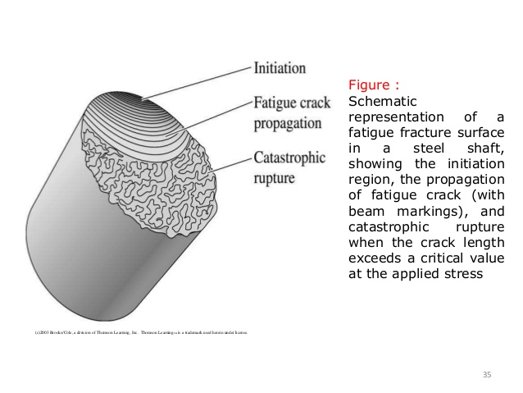
BEACHMARK
Macroscopically visible and formed when the fatigue crack growth is interrupted.
These are also known as clam shells or crack-stop lines.
If machine run for some hours and then stop for one day - all these cases specimen carries signature.
These will not be present if the part is operated continuously or with only brief interruption in service.
Beachmarks must not be confused with striations, although they frequently are present on the same crack surface; there may be thousands of microscopic striations between each pair of macroscopic beach marks

Slide 33
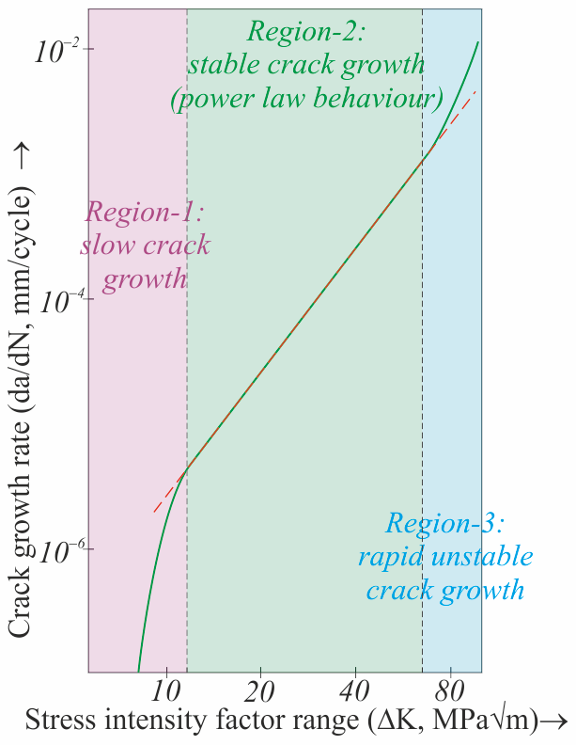
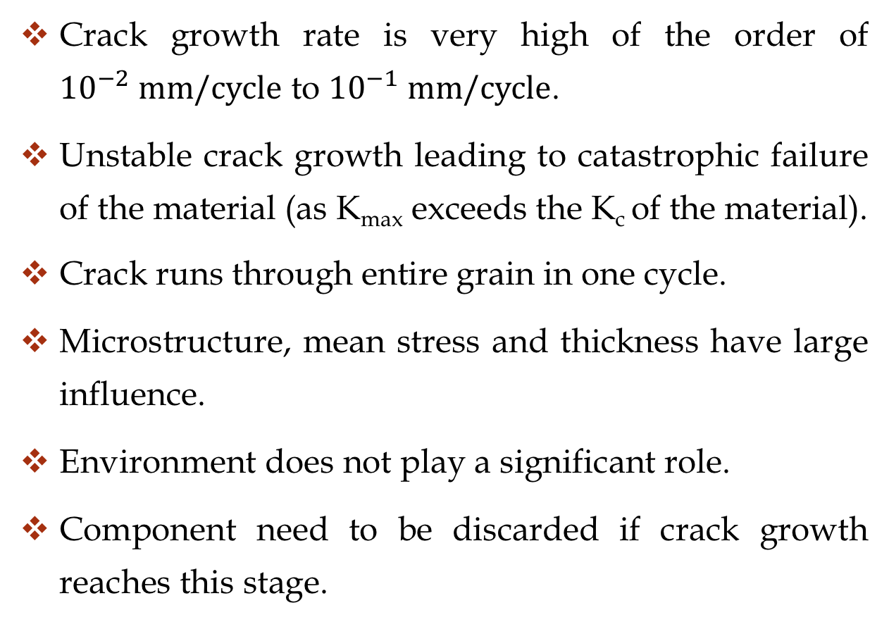
Stage 3 – Failure
Crack growth rate is very high of the order of ${10}^{−2} mm/cycle$ to ${10}^{−1} mm/cycle$.
Unstable crack growth leading to catastrophic failure of the material (as K_{max} exceeds the K_{c} of the material).
Crack runs through entire grain in one cycle.
Microstructure, mean stress and thickness have large influence.
Environment does not play a significant role.
Component need to be discarded if crack growth reaches this stage.

Slide 34
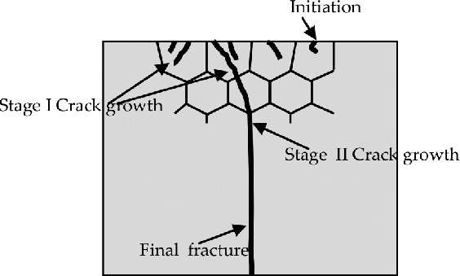

Slide 35
Creep
Creep is a time-dependent process where a material under an applied stress exhibits a dimensional change at elevated temperature.
Ex.: Turbine rotors, high pressure pipe lines, beams in the roof of building.
Can result in fracture without increasing the load.
Creep is dominant at higher temperature.
Elevated temperature means T > 0.40 TM
TM = Melting temprature
For amorphous polymers ,room temperature is enough for creep.

Slide 36
MECHANISMS OF CREEP
Different mechanisms are responsible for creep.
It depends on the materials, type of loading and temperature conditions.
The mechanisms include
Stress-assisted vacancy diffusion
Grain boundary sliding
Dislocation Glide

Slide 37
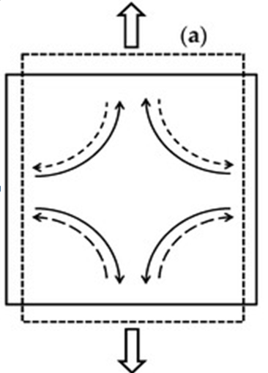
VACANCY DIFFUSION
Atoms have high diffusion tendency at high temperature.
Atoms diffuses towards the direction parallel to the tensile stress axis.
Vacancies diffuses towards the direction perpendicular to the tensile stress axis.
Grains elongates in the direction of tensile stress.
This is example for substitutional diffusion (does not obey Ficks Law)
Elongation obtained by diffusion and not by dislocation.

Slide 38
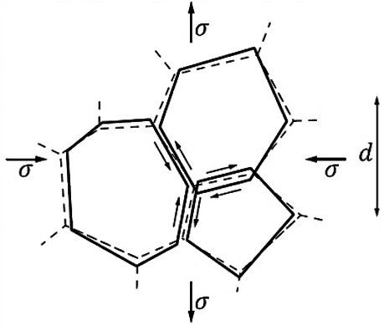
GRAIN BOUNDARY SLIDING
Grain boundary become weaker at high temperature (above 0.5Tm).
Behave like a viscous liquid
separating neighbouring grains.
Under the stress, the grains will slide over grain boundary.

Slide 39
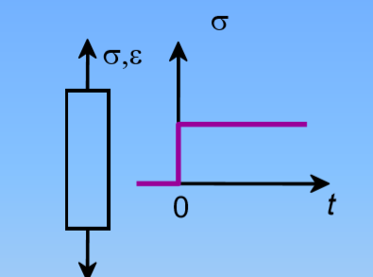
CREEP TEST
To determine the change in the deformation of materials when stressed below yield point.
Carried out at constant temperature with the help of electric furnace.
Dead load applied.
Same specimen as used in Tensile test.
Strain measured with strain gauge or extensometer.
Strain is plotted with time.
Test usually ends with rupture (creep failure).

Slide 40
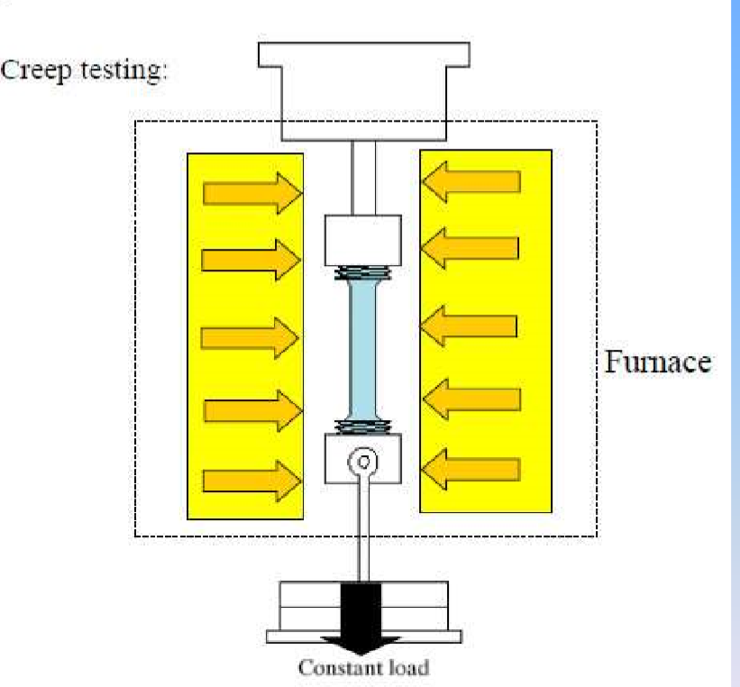
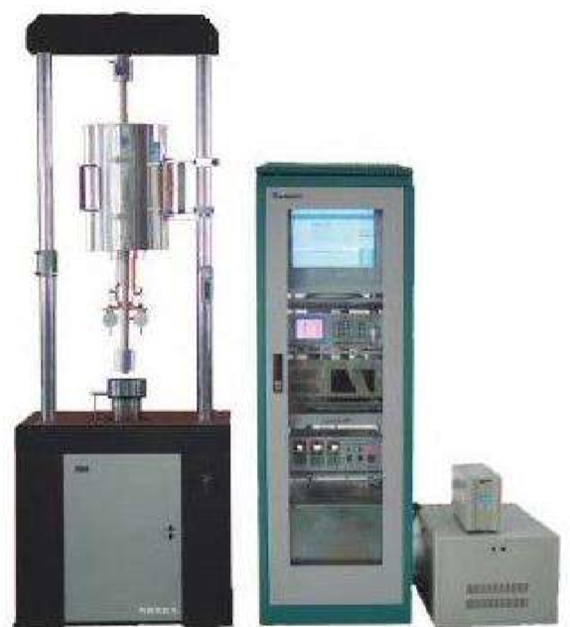
Creep Testing Machine

Slide 41
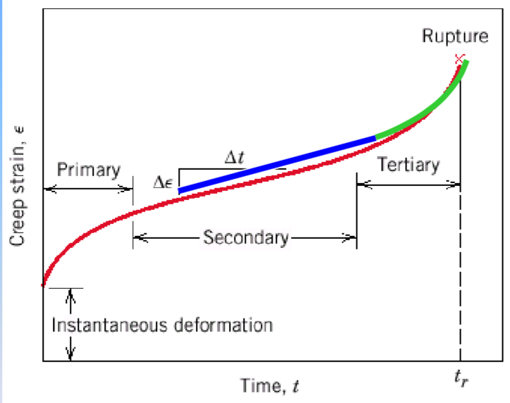
CREEP CURVE
Primary Creep:
Slope (creep rate) decreases with time due to work hardening.
Secondary Creep:
Steady-state i.e., constant slope.
Rate of straining is constant.
Balance of work-hardening and recovery.
Tertiary Creep:
Slope (creep rate) increases with time.
Formation of internal cracks, voids, grain boundary, separation, necking, etc.

Slide 42
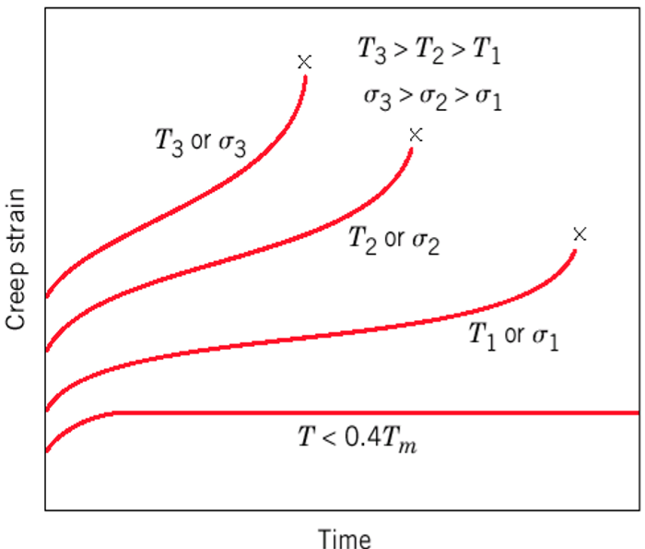
Creep with increasing stress or temperature
The instantaneous strain increases.
The steady-state creep rate increases.
The time to rupture decrease.

Slide 43
PREVENTION OF CREEP
Materials having high thermal stability and higher melting point resist creep.
A fine grained material resist dislocation.
A coarse grained material exhibit better creep resistance. This is because of more resistance to grain boundary sliding.
Precipitation hardening alloys improve creep resistance.
Dispersion hardening also improves creep resistance.

